Slide 1
LUMIRA - PREPARE
Milind Parab

Slide 2
Filters.
Milind Parab

Slide 3
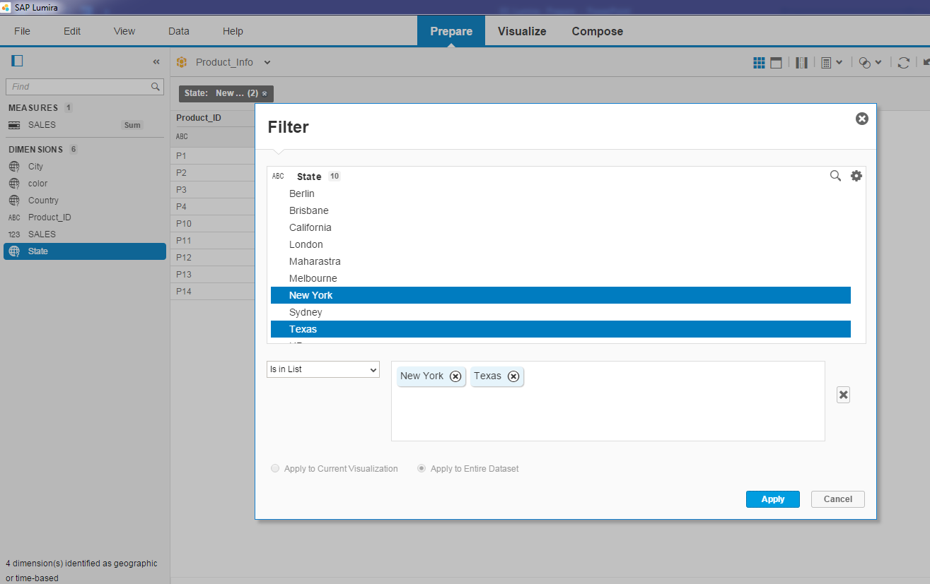
Filter: Is in List.

Slide 4
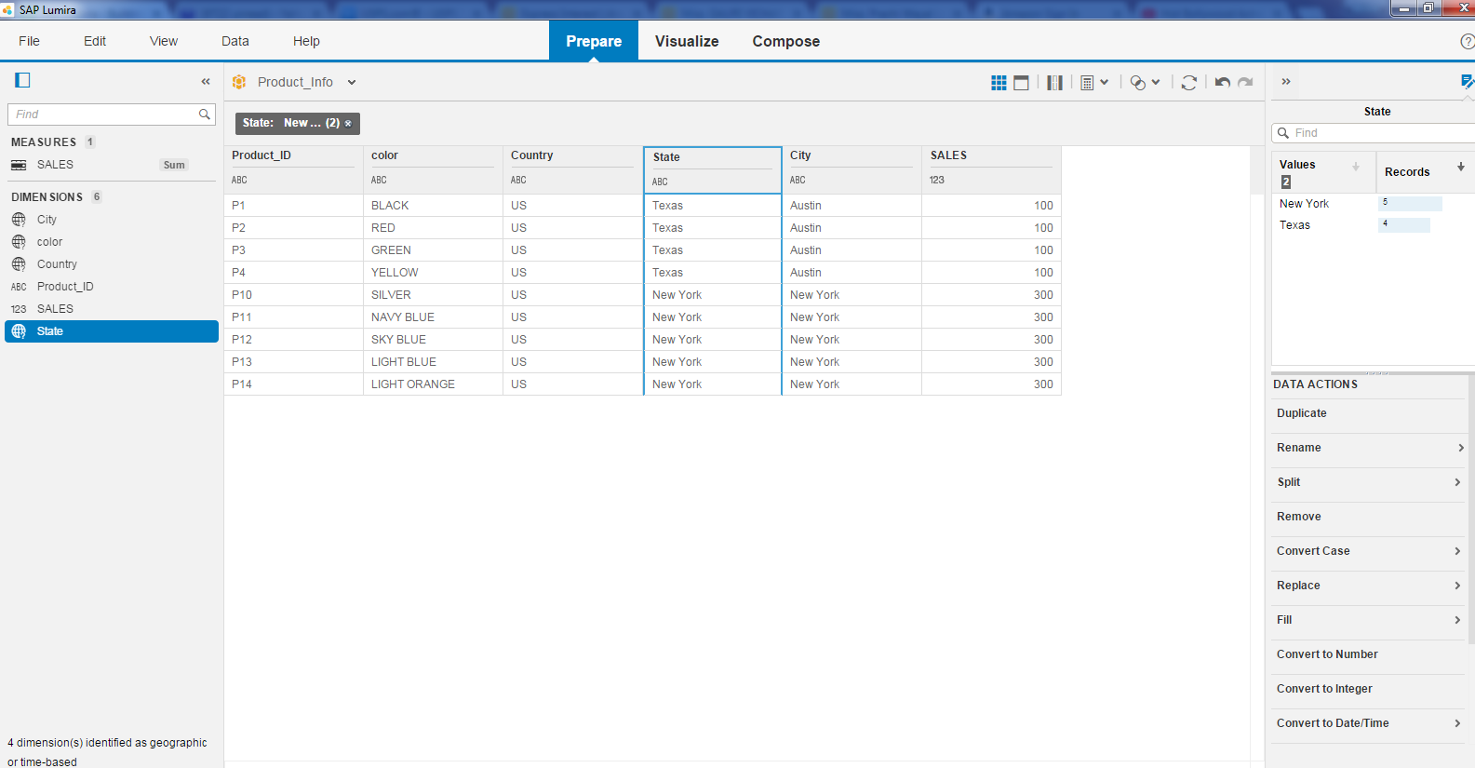
Apply Filter.

Slide 5
SORT ORDER.
Milind Parab

Slide 6
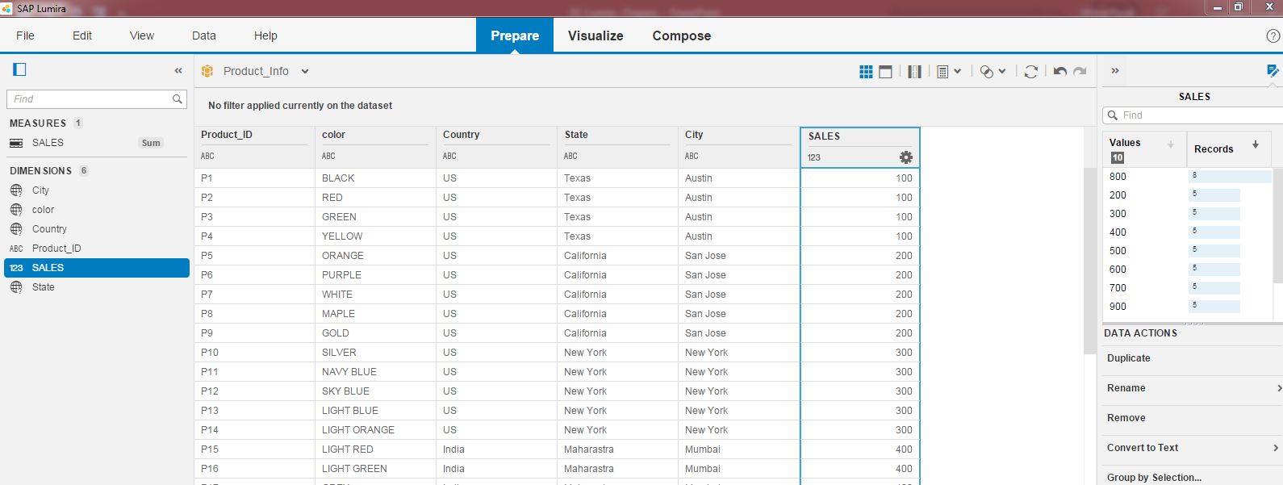
Click on asterisk to Sort Data in Asc or Des.

Slide 7
Rename function.
Milind Parab

Slide 8
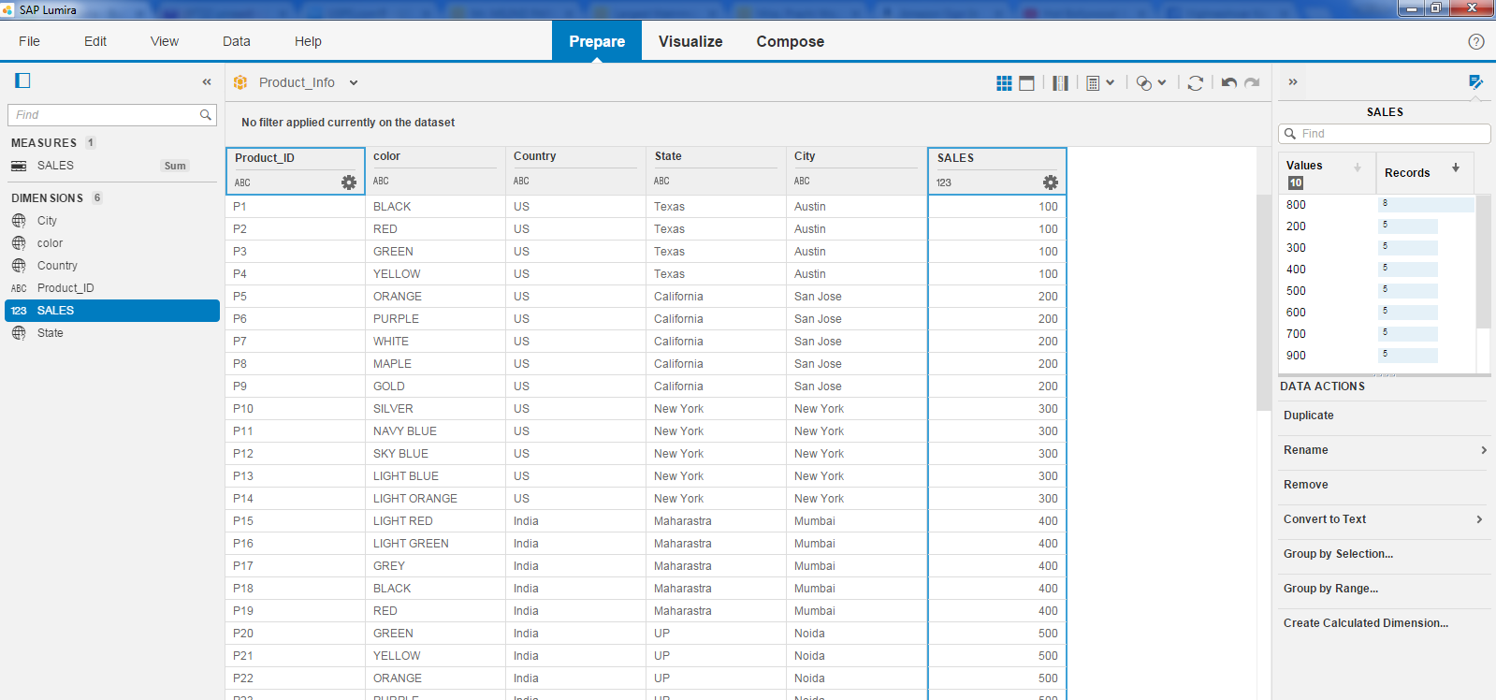
Rename Function.

Slide 9
MERGE function.
Milind Parab

Slide 10
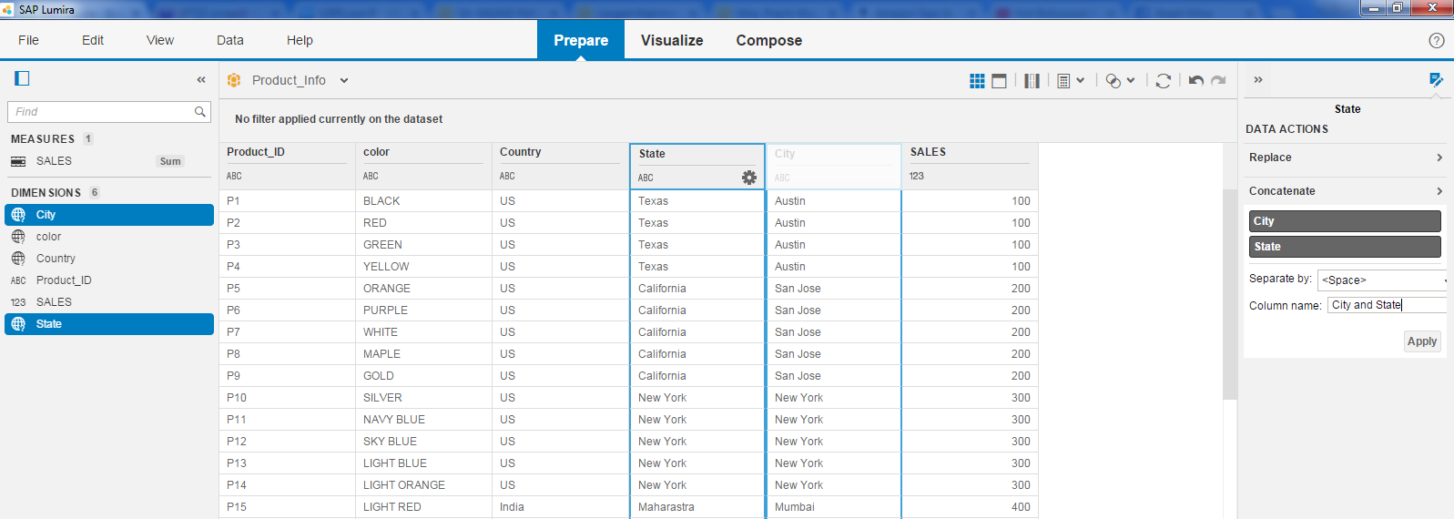
Merge Function.

Slide 11
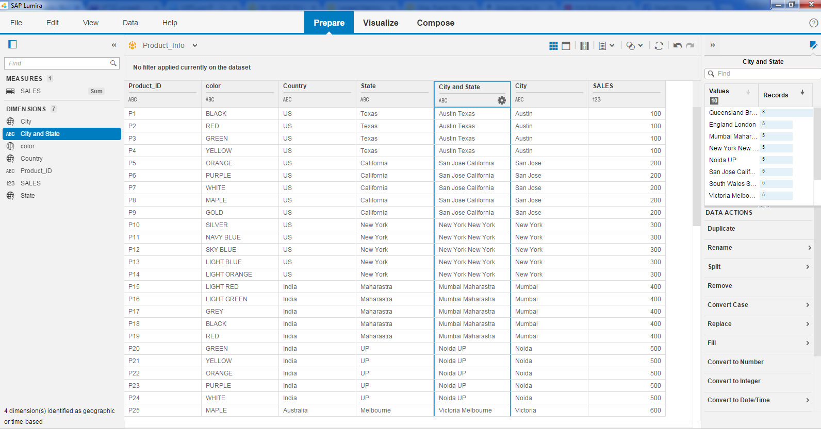
New Function.

Slide 12
SPLIT function.
Milind Parab

Slide 13
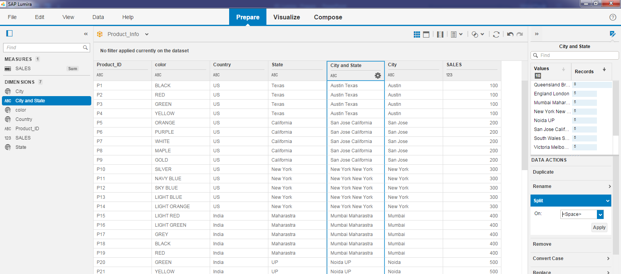
Split Function.

Slide 14
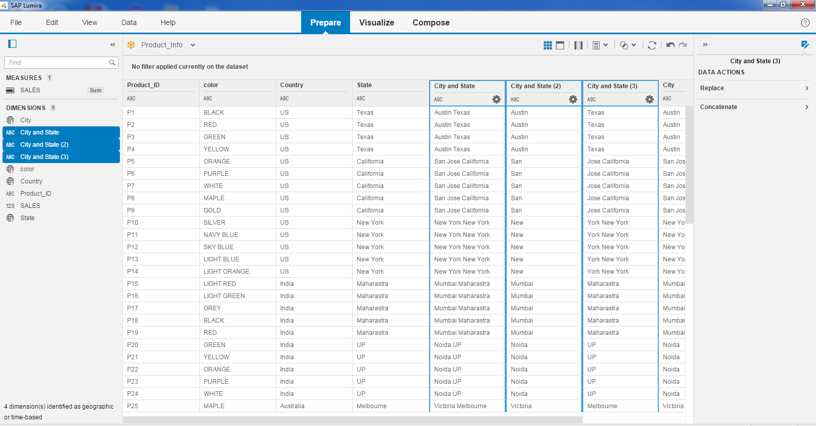
Cont.

Slide 15
DELETE COLUMN.
Milind Parab

Slide 16
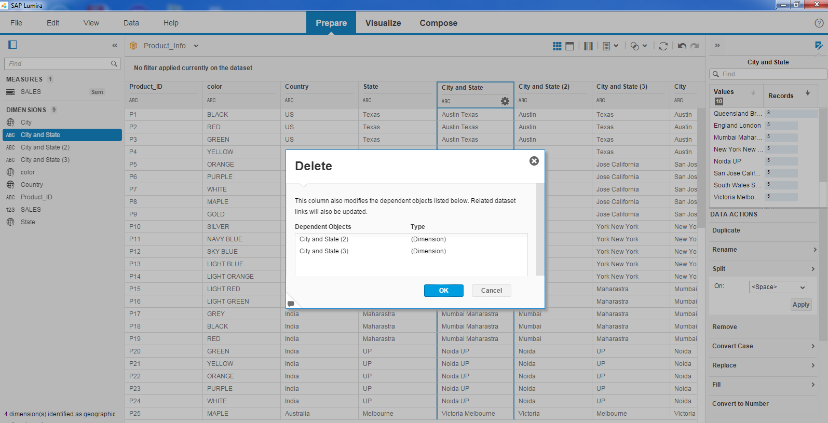
Remove Function.

Slide 17
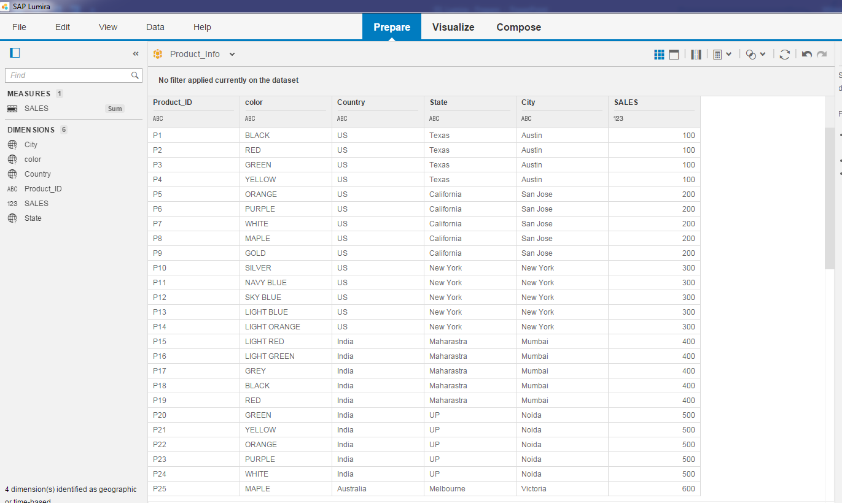
Dependent objects are also get deleted.

Slide 18
REPLACE FUNCTION.
Milind Parab

Slide 19
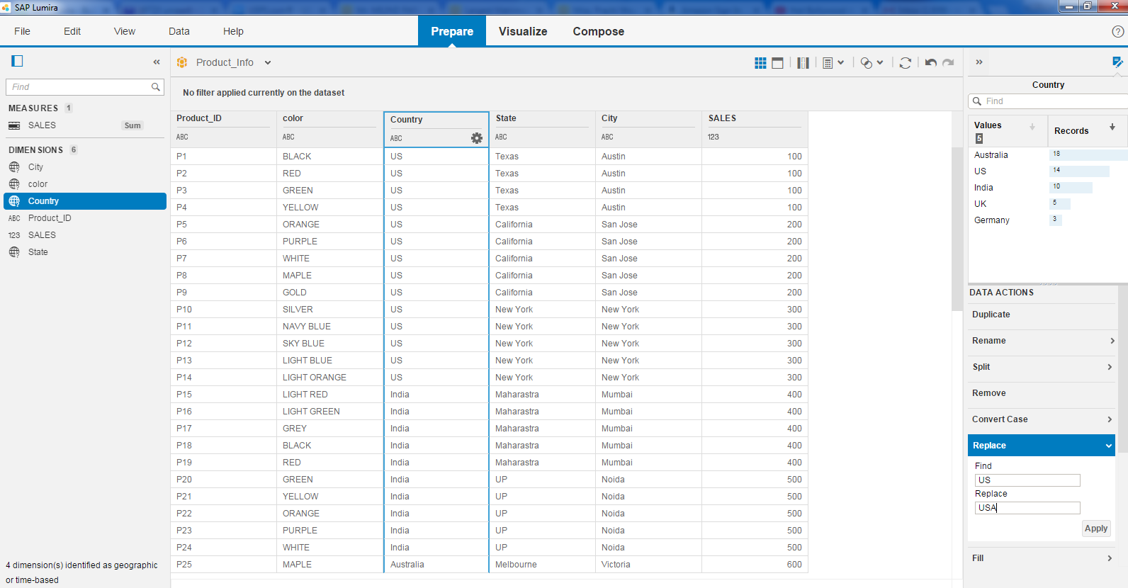
Replace US with USA.

Slide 20

Cont.

Slide 21
TRIM FUNCTION.
Milind Parab

Slide 22
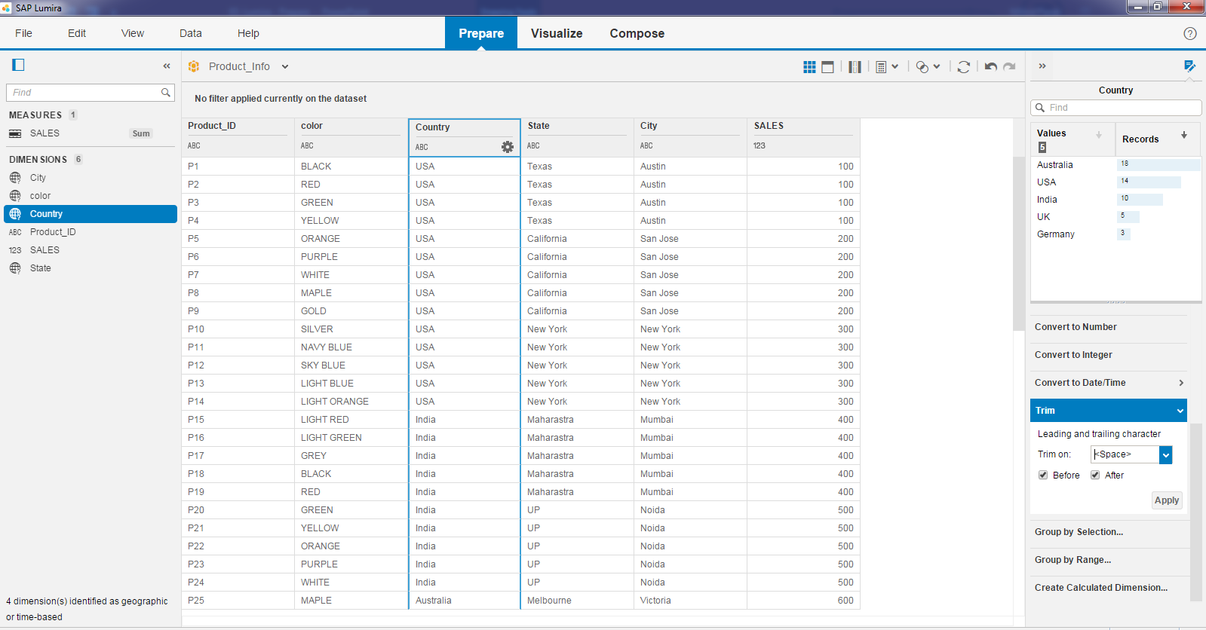
Trim Function.

Slide 23
GROUP BY RANGE.
Milind Parab

Slide 24
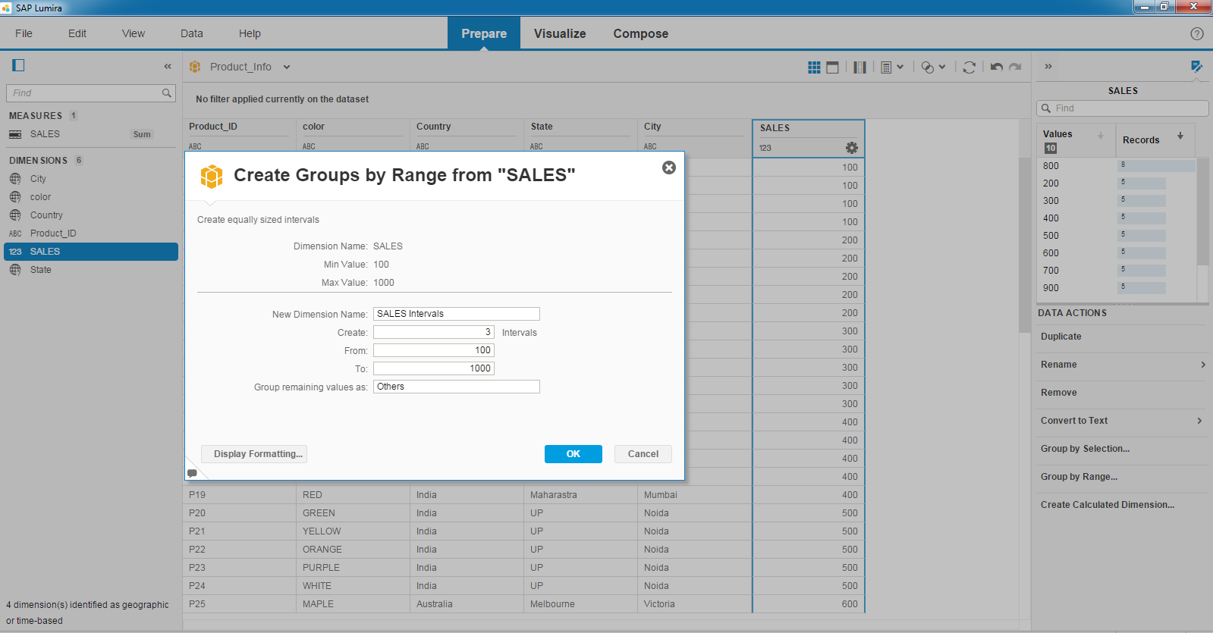
Group by Range.

Slide 25
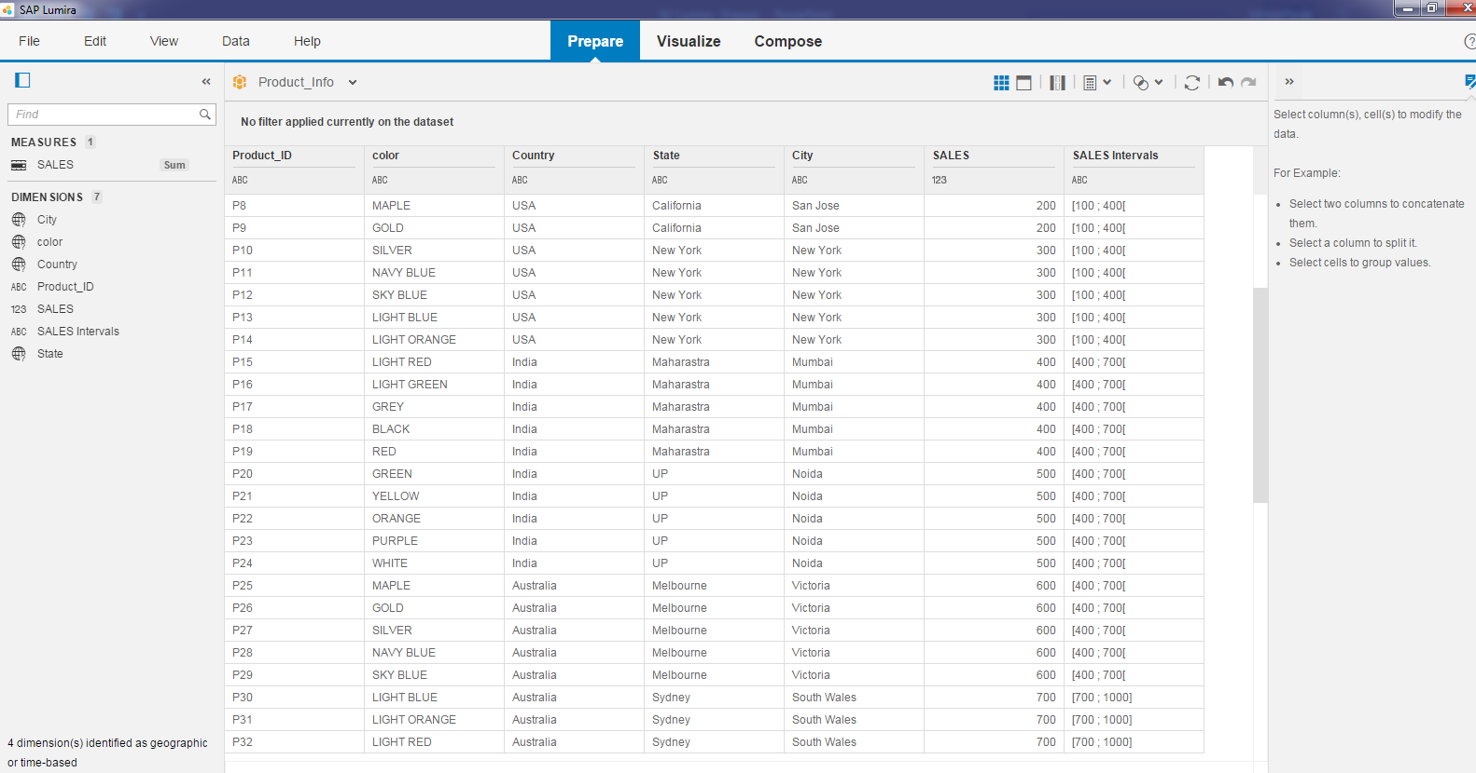
New group of sales interval has been created.

Slide 26
CALCULATED COLUMN.
Milind Parab

Slide 27
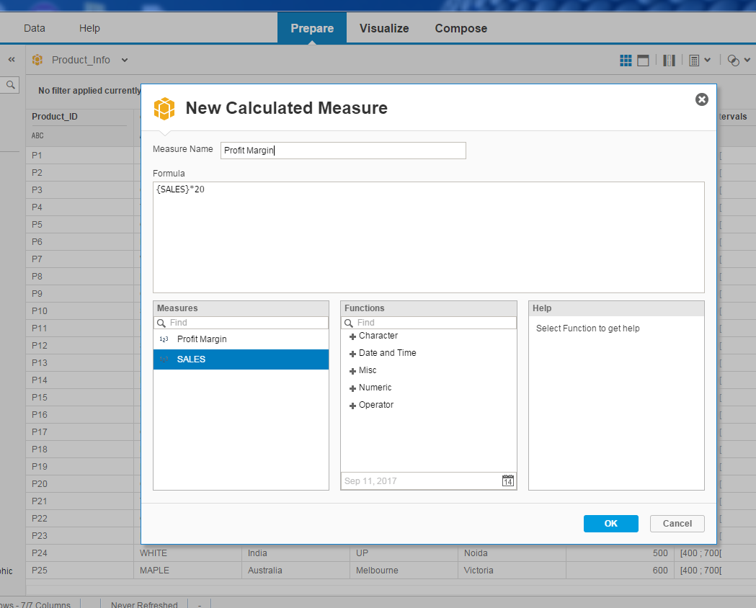
Calculated Column

